Slide 1

Concept Generation & Evaluation Chapter 4 – cont’d

Slide 2
Learning Objectives
By the end of this section, you should:
Understand the importance of creativity, innovation, concept generation, and critical evaluation in engineering design.
Be familiar with barriers that hinder creativity.
Be able to apply strategies and formal methods to generate concepts.
Be able to apply techniques for the evaluation of design concepts.

Slide 3
Motivation
Creativity is part of being an engineer.
We often start with a single solution to a problem and then pursue it as the only possibility.
You need to be creative and generate a variety possible designs.
You need to be able to evaluate different designs.
You need to be BE ABLE TO DEFEND YOUR DESIGN!
Companies prefer innovative engineers.

Slide 4
Product Development

Slide 5
Concept Generation
Search Externally
Literature review
Search and review existing products
Benchmark similar products
Interview experts
Search Internally
Brainstorming/brainwriting
Nominal Group Technique
Concept Table/Fans

Slide 6
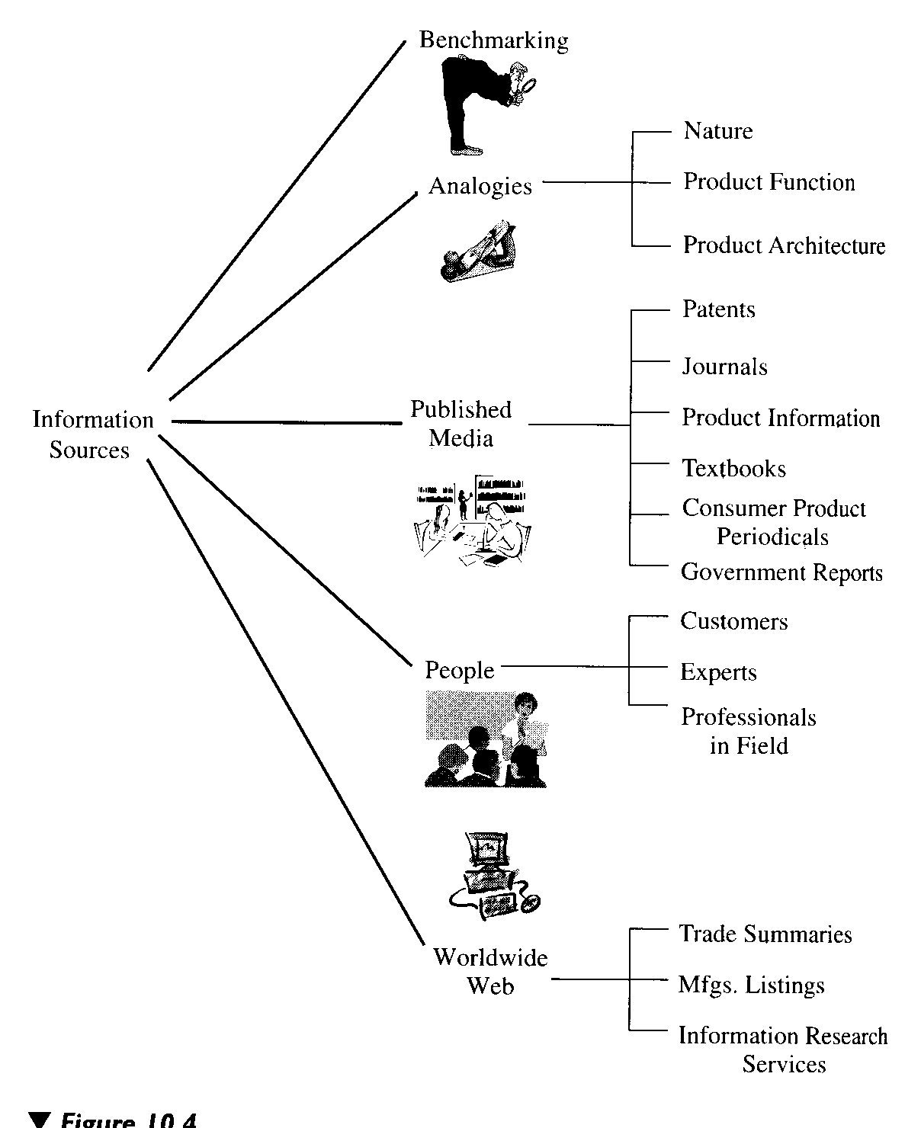
Searching Information Gathering
Knowledge is Power – it leads to innovation

Slide 9
Brainstorming
Generating Many Concepts

Slide 10
Brainstorming
Rules for group brainstorming
No evaluation or judgment of ideas permitted.
Encourage wild ideas.
Focus on quantity, not quality (can always toss later!)
Build upon, combine, or modify the ideas of others (SCAMPER).
Record all ideas.

Slide 11
Concept Generation Basic Methods
Intuitive Method
Focuses on idea generation from within an individual or group of individuals.
The intent is to remove barriers to divergent thinking and promote creative thinking (Brainstorming).
Directed (Logical) Method
A systematic, step-by-step approach to searching for a solution.
It relies on technical information, guidelines and expertise.

Slide 12
Brainstorming
An intuitive method of generating concepts.
The overall goal is to obtain several concepts that might work.
All team members are encouraged to be open and uninhabited during the early sessions.
No need to adhere to product specifications, focus on the functional needs of the product.
The primary advantage of brainstorming is the ability of set of individuals to collectively build on each other to generate new ideas that would not arise individually.

Slide 13
Brainstorming Guidelines
Select a group leader, to prevent judgments and to encourage participation by all.
Form the group with 5 to 15 people.
Do not confine the group to experts in the area.
Individuals could come to the session with a set of ideas.
Limit the brainstorming to 45 minutes.
Do not include bosses, managers or supervisors in the group.

Slide 14
Brainstorming Idea Generators
Make Analogies
What analogies exist in nature? What analogous products exist? How do these products solve the same product functions?
Wish and wonder
What if …..?
Sketch/use physical models
What would an idea look like? How does this model satisfies the function? What can we change?

Slide 15
Brainstorming Idea Generators
Eliminate or minimize
Can we remove a feature? What can we use to replace a feature? What if a feature were smaller? Could we divide it into two parts?
Modify and magnify
What can be made larger or extended? What can be exaggerated? What can add extra value? What can be duplicated? Convert a round section to a straight one? Can motion, form, shape, color, sound, odor be changed?
Combine
Can we combine purposes? How about assortments? How about blending?

Slide 16
Brainstorming Idea Generators
Reverse or rearrange
Should we turn it around? Up instead of down?Consider it backwards? What other arrangements might be better? Interchange components? Do the unexpected?
Substitute
What can be substituted?
Adapt
What else is like this? What other ideas this suggest? What could we copy?

Slide 17
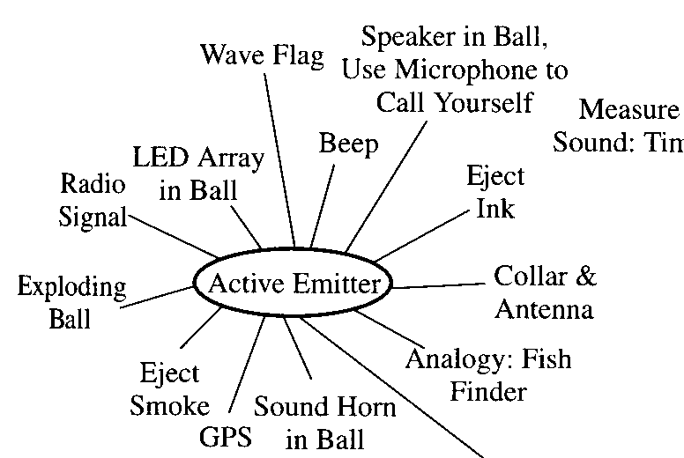
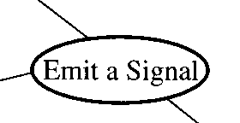
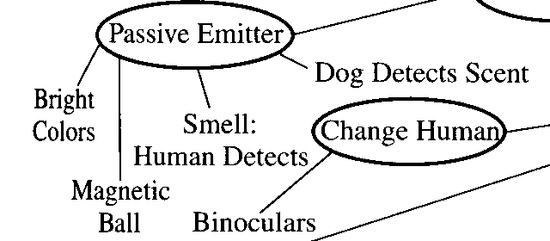

Brainstorming Memory Map Example
Problem: Detecting location of golf balls across a golf course

Slide 18
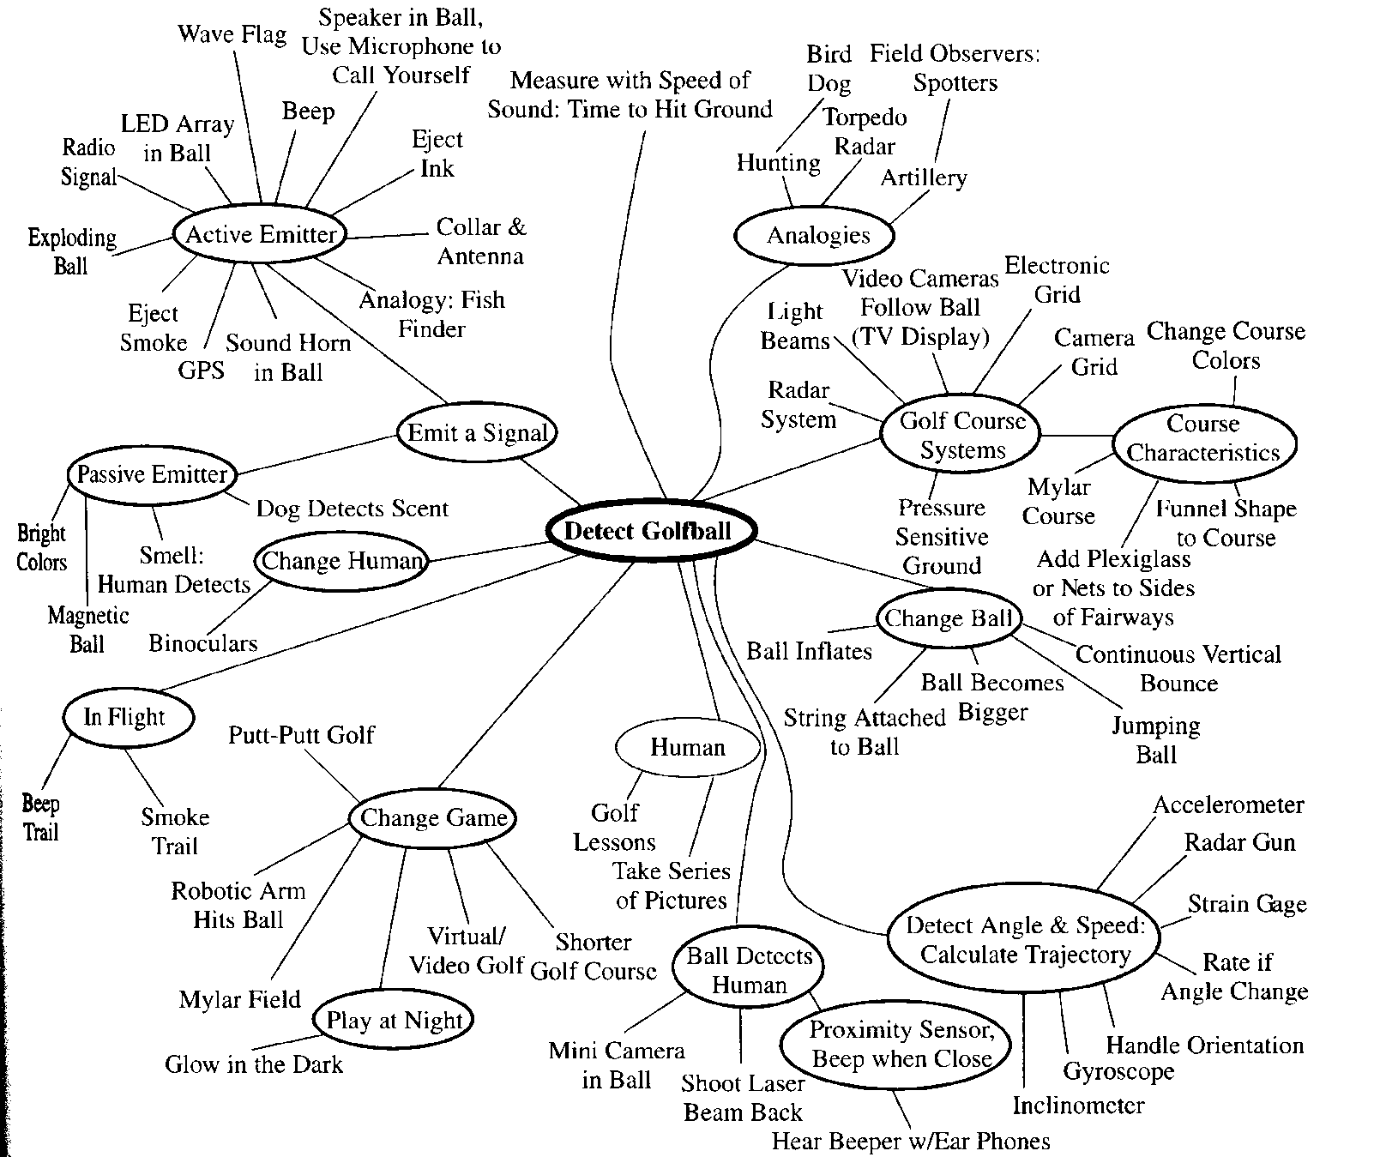
Brainstorming

Slide 19
Brain-writing Sketching and the 6-3-5 Method
The traditional brainstorming relies on verbal communications.
Idea generation may be dominated by a small number of aggressive members.

Slide 20
Brain-writing Sketching and the 6-3-5 Method
Procedure for the 6-3-5 Method
Team members are arranged around a circular table to provide continuity. Six (6) members are ideal.
Each member sketches three (3) ideas for the product configuration or functions.
Sketches should be the focus of this activity.
The top five (5) product functions with respect to the customer needs are considered.

Slide 21
Brain-writing Sketching and the 6-3-5 Method
The three ideas are passed to the right. A certain time limit is set to add additional ideas and to modify or extend the ideas. This is done for five (5) rounds.
No verbal communication until a round is completed.
Traditional brainstorming may be implemented after a few rounds of 6-5-3 sessions.
The focus of the modifications during the passing of ideas should be on advancing the ideas, not on negative criticism.

Slide 22
Concept Evaluation
Decision Methods (some of them)
Strength & Weakness Analysis
Analytical Hierarchy Process (Decision Matrix)
Pugh Concept Selection

Slide 23
Strength & Weakness Analysis
A simple technique for evaluation of concepts.
Identify and list strengths and weaknesses of each concept.
To make more analytical, assign subjective weights to strengths and weaknesses (plus and minus factors) and sum them.

Slide 24
AHP (Decision Matrix)
 |  | Design Option 1 | Design Option 2 |  | Design Option n
Criteria 1 |  | α₁₁ | α₁₂ |  | α_{1n}
Criteria 2 |  | α₂₁ | α₂₂ |  | α_{2n}
Criteria m |  | α_{m1} | α_{m2} |  | α_{mn}
Score

Slide 25
Decision Matrix: Steps
Step 1: Determine the selection criteria
Step 2: Select the criteria weightings
Step 3: Identify and rate alternatives relative to the criteria
Step 4: Compute the scores
Step 5: Review the decision
“You can use all the quantitative data you can get, but you still have to distrust it and use your own intelligence and judgment.”—Alvin Toffler

Slide 26
Pugh Method for Concept Selection
It is an iterative creative idea or concept evaluation technique that uses criteria derived from the “voice of the customer” in an advantage-disadvantage matrix.
Each concept is evaluated against a datum (baseline) using a three-way (multi-way in general) evaluation scheme.
EVALUATION SCALE
+ means substantially better
― means clearly worse (or flawed)
S means more or less the same

Slide 27
Problem Solving Process
Data Collection, Analysis
PROBLEM DEFINITION
Brainstorming
IDEA GENERATION
Pugh Method
IDEA EVALUATION
IDEA JUDGMENT
IMPLEMENTATION
Related Task
Goals, Objectives
Customer/Needs Analysis
List of Criteria
CONCEPTUAL IDEAS
Cost Analysis
IMPLEMENTATION
PLANNING
OPTIMIZED SOLUTIONS
Final Review
Go/No Go Decision
BEST SOLUTION
Pilot Program/Prototype

Slide 28
Pugh Concept Selection
Select the comparison criteria
Determine weights for the criteria
Determine the concepts
Select baseline concept, initially believed best
Compare other concepts to baseline:
+1 better than, 0 equal to, -1 worse than.
Compute weighted score for concepts, not including the baseline.
Examine concepts: retain, update, or drop.
Synthesize best elements of others where possible.
Update table & iterate until best concept emerges.

Slide 29
Pugh Concept Table
 |  | Option 1 (Reference) | Option 2 | Option 3 | Option 4
Criteria 1 | 4 | - | 0 | 0 | +1
Criteria 2 | 5 | - | +1 | -1 | 0
Criteria 3 | 2 | - | -1 | 0 | +1
Criteria 4 | 1 | - | +1 | +1 | -1
Score |  | - | 4 | -4 | 5
Continue? |  | Combine | Yes | No | Combine

Slide 30
Team Role in the Pugh Method
Discussions reveal arbitrary criteria. Team members gain insight into the problem and clearly understand the criteria which become better defined.
The discussion also leads to creative leaps between different concepts and idea synthesis, as flaws are attacked together and the team experiences synergy.
The resulting new concepts are better than the original ideas. No flaws are overlooked; late changes are eliminated, and invulnerable products are developed that will succeed in the marketplace.
The team develops consensus about the best solution.

Slide 31
The Pugh Method — Phase I
The problem solving team brainstorms and ranks a list of 15 to 20 evaluation criteria based on customer needs.
The team develops imaginative concepts.
The matrix is prepared on a large wallboard, and the best existing scheme is chosen as the benchmark/datum.
Each concept is presented by its champion and then discussed and evaluated against the list of criteria and the datum. If new ideas come up during this process, they are entered on the matrix as new concepts.

Slide 32
The Pugh Method — Phase I (cont’d)
5. The results of the matrix are evaluated. The “best” datum for the next round is chosen, and criteria are clarified as needed to make them more useful.
6. The team works to strengthen the positives and remove the negatives through synthesis and new ideas (including the datum).
7. These improved concepts are entered in a new matrix and evaluated.
8. The process is repeated for one or more rounds, with the strongest concept chosen as the datum each time.

Slide 33
The Pugh Method — Phase II
Over a period of time, the team further develops the best concepts, runs analyses, and researches missing information. The solutions/concepts are now worked out or developed to more detail.
Weaker ideas are dropped (after their good points have been judged for use elsewhere).
The matrix and the improvement process are iterated until a winning concept emerges. All team members understand why this solution is best—all good points have been strengthened and all negatives overcome.

Slide 46
Summary
Open your mind to creativity
Innovation is important
There are strategies to apply
Apply Methods of Concept Generation
Search externally: Patents, research, experts
Search internally: SCAMPER, Morph Charts, Concept Fans, Brainstorming, Nominal Group Technique
Evaluate Concepts Critically
Strengths/Weaknesses
Decision Matrices
Pugh Concept Selection

